Slide 1


Airline Passenger Satisfaction
Presented by:
Rahaf Alturbaq
Abdullatif Alsabr
Aljoharah Alaqeel

Slide 2
Outline
Introduction
Challenges
Models
Conclusion
1
2
3
4
5
6
7
About Dataset
Algorithm
Tools

Slide 3
Introducion
The fast growth number of air transportation and air passengers require better service from airports. Airports need to response rapidly to the changes of air passenger in order to meet their demands.
Measuring customer satisfaction is a key element for modern businesses as it can significantly contribute to a continuing effort of service quality improvement, in order to meet customer expectations and achieve higher quality levels.

Slide 4
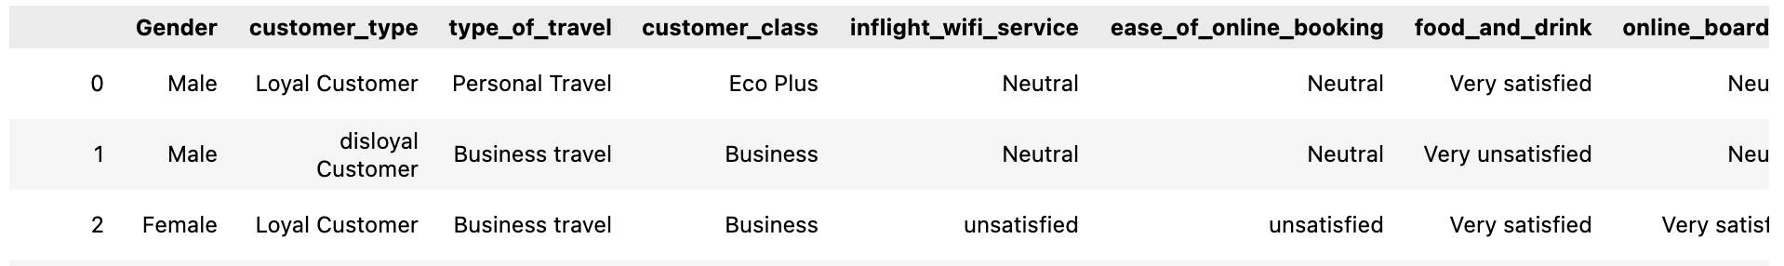
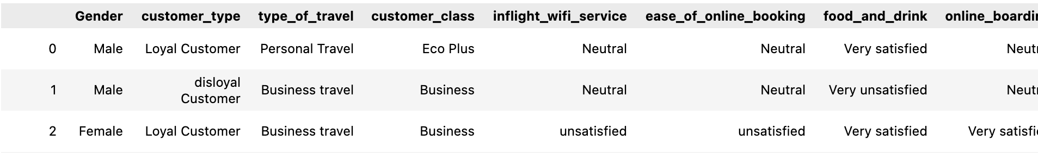
About Dataset
Our Dataset contained 23 columns, and 129880 rows before cleaning
After cleaning the dataset 19 columns and 129487 rows after cleaning
Dataset Resource: Kaggle

Slide 5
Challenges
 | EDA | Model
Null Values | Dropped
Duplicated and unnecessary data | Dropped
Object values | Did not change | Converted values using dictionay and lmbda
Minutes | Converted using range | Did not change
Models Scores |  | Imporved models using Gridsearch

Slide 6
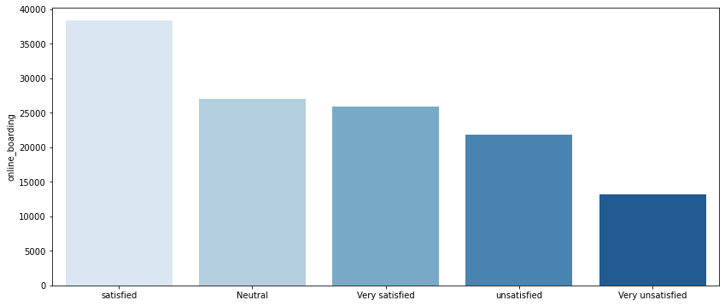
Algorithm (EDA)
Based on online boarding what is the highest feedback rate?

Slide 7
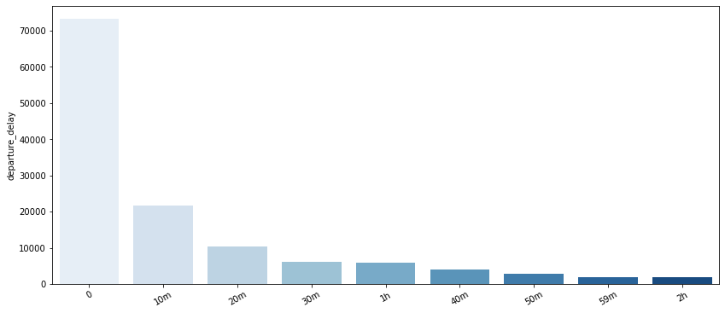
Algorithm (EDA)
The most important feature affecting passenger satisfaction (Departure Delay)

Slide 8
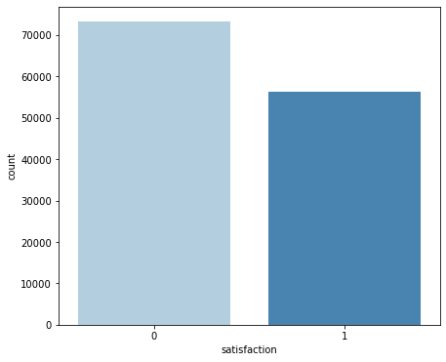
Checking Imbalanced Data

Slide 9
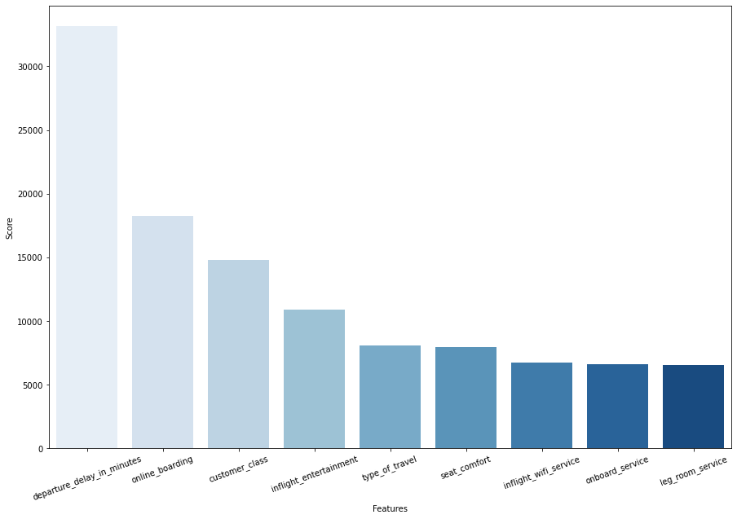
Selecting Features ( by K Best Score)

Slide 10
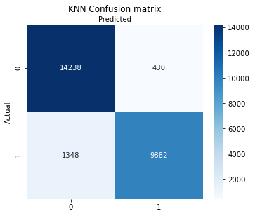
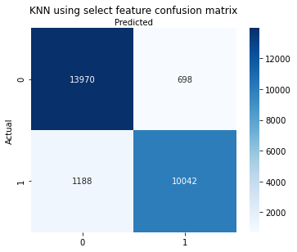
KNN
Classification Models
KNN after feature selection
Best hyperparameter: ‘brute’ , k= 11

Slide 11
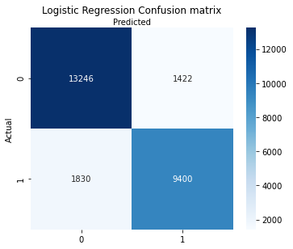
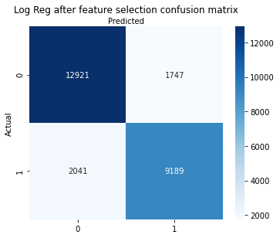
Logistic Regression
Classification Models
Logistic Regression after feature selection
Best hyperparameter: solver ‘liblinear’

Slide 12
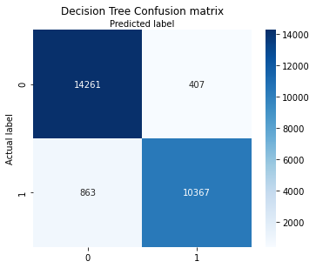
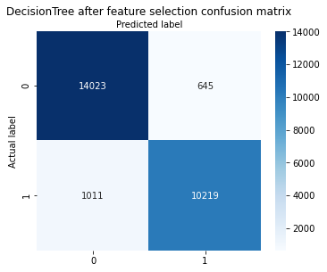
Decision Tree
Classification Models
Decision Tree after feature selection
Best hyperparameter used: ‘entropy’ , max_depth 12

Slide 13
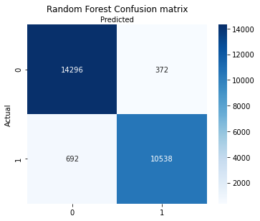

Random Forest
Classification Models
Random Forest after feature selection
Best hyperparameter used: ‘entropy’ , max_depth 12

Slide 14
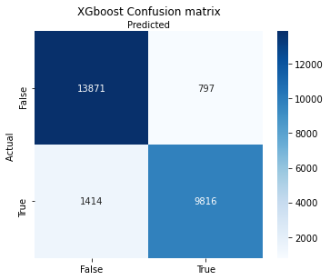
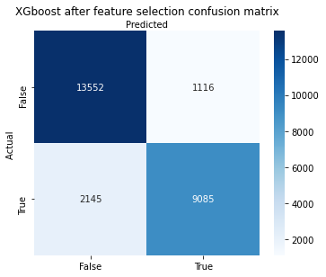
Xgboost
Classification Models
Xgboost after feature selection
Best hyperparameter used:
reg :linear
cols sample by_tree 0.3
learning rate: 0.1
Max_depth: 5
Alpha: 10
n_estimatior = 10

Slide 15
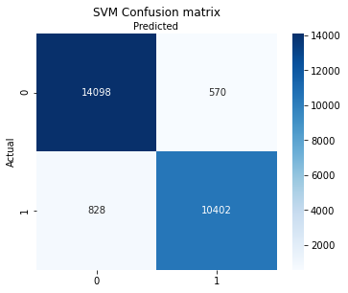
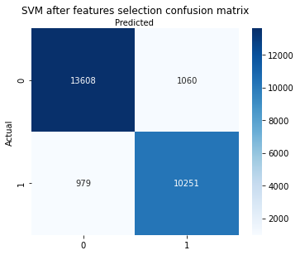
Support Vector Machine
Classification Models
Support Vector Machine after feature selection
Best hyperparameter used:
C = 10
Kernal = rbf
Gamma = 0.01

Slide 16
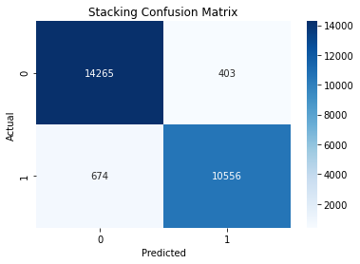
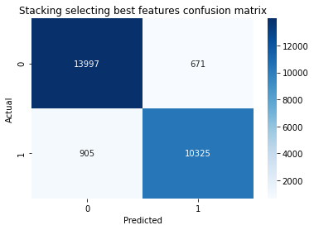
Before feature selection
Stacking
After feature selection

Slide 17
Models Accuracy
Before & After feature selection
 | Before | After
KNN | 93% | 93%
Logistic Regression | 87% | 85%
Decision Tree | 95% | 94%
Random Forest | 96% | 94%
Xgboost | 91% | 87%
Support Vector Machine | 95% | 92%
Stacking | 96% | 94%

Slide 18
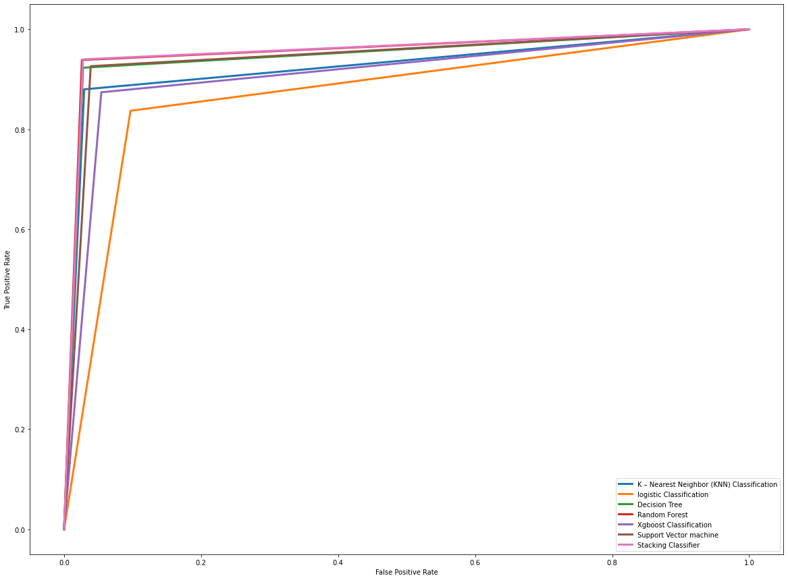
Comparing models

Slide 19





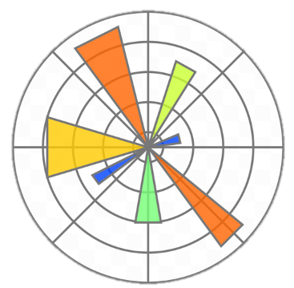


Tools

Slide 20
Conclusion:
Considering the most features affecting passenger satisfaction such as departure delay, online boarding, inflight entertainment, seat comfort and baggage handling in addition to many other features.
We should consider those features and improve them in order to meet customer expectations, achieve higher quality levels, gain more loyal customers and maintain a profitable business.
Goal:
Future up to date features could contribute to improve a profitable business using our previous models.

Slide 21
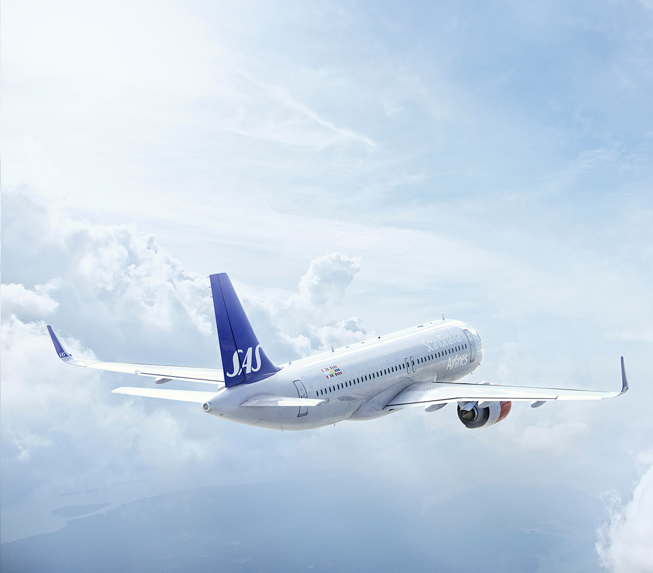
Thank you for your attention.
Any Question?

